Slide 1

Introduction to Basic Manufacturing Process Lab (ME29201)
Demonstration of Vertical Milling machine - Fabrication of flat surface and machining of slot.
Department of Mechanical Engineering IIT Kharagpur

Slide 2
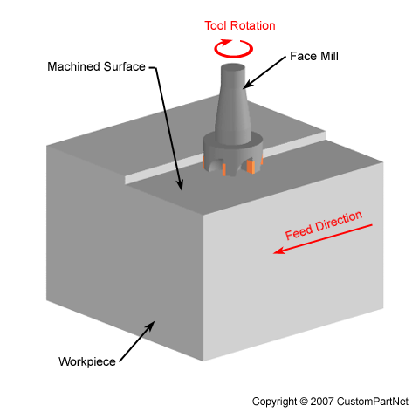
Milling?
Act or Process of cutting in a mill (plant or workshop).
Process of machining using rotary cutters to remove material by advancing a cutter into a workpiece.
Milling cutter
Fig. 1: Schematic of milling process [1]

Slide 3
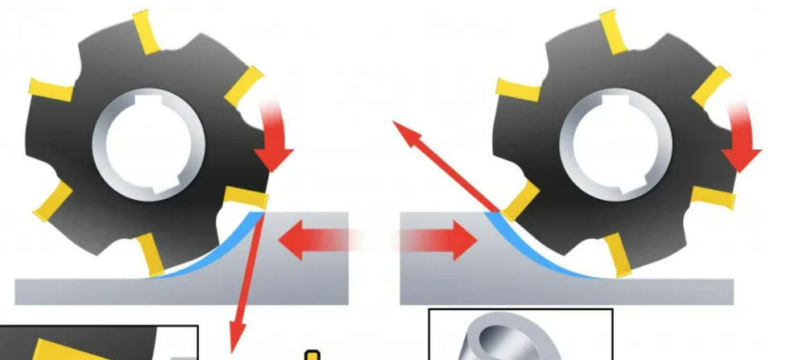
Principle
Works on the principle of rotary motion. [2]
Up milling
down milling
Fig 2. schematic view of conventional up and down milling [3]

Slide 4
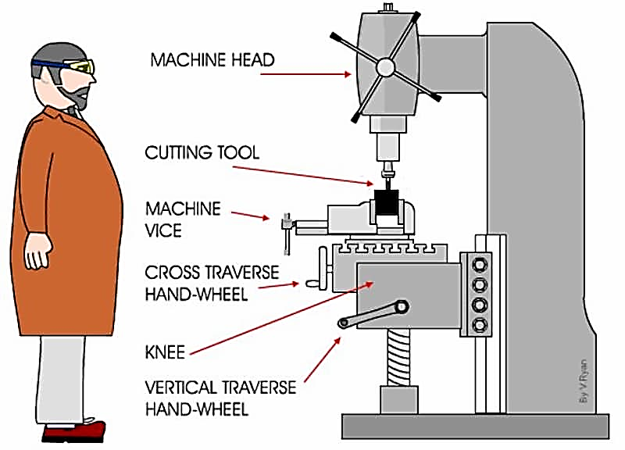
Vertical milling
Spindle is in vertical orientation which holds as well as rotates the cutting tool. The workpiece remains stationary.
Fig. 3: Schematic of vertical milling [4]

Slide 5
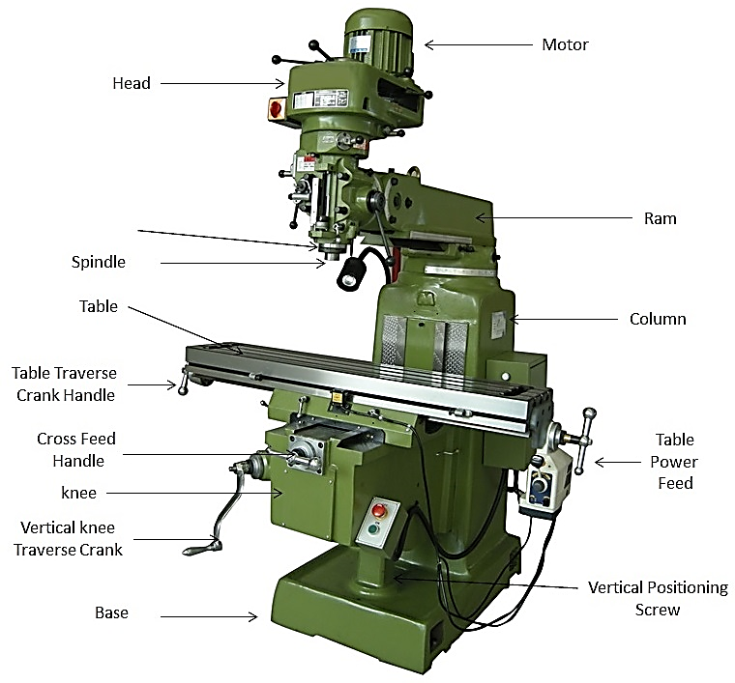
Fig. 4: Vertical milling machine [5]

Slide 6
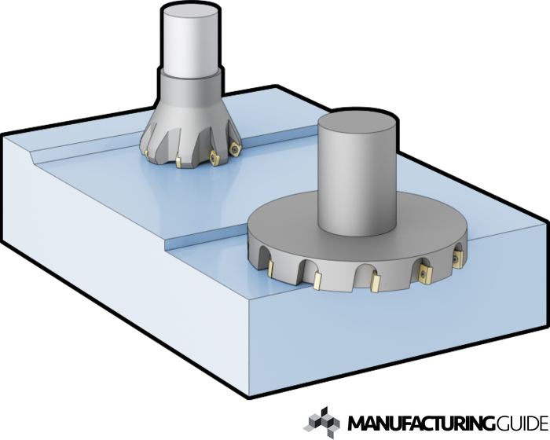
Face Milling
Cutting a flat surface perpendicular to the axis of milling cutter.
Fig. 5: Schematic of face milling operation [6]

Slide 7
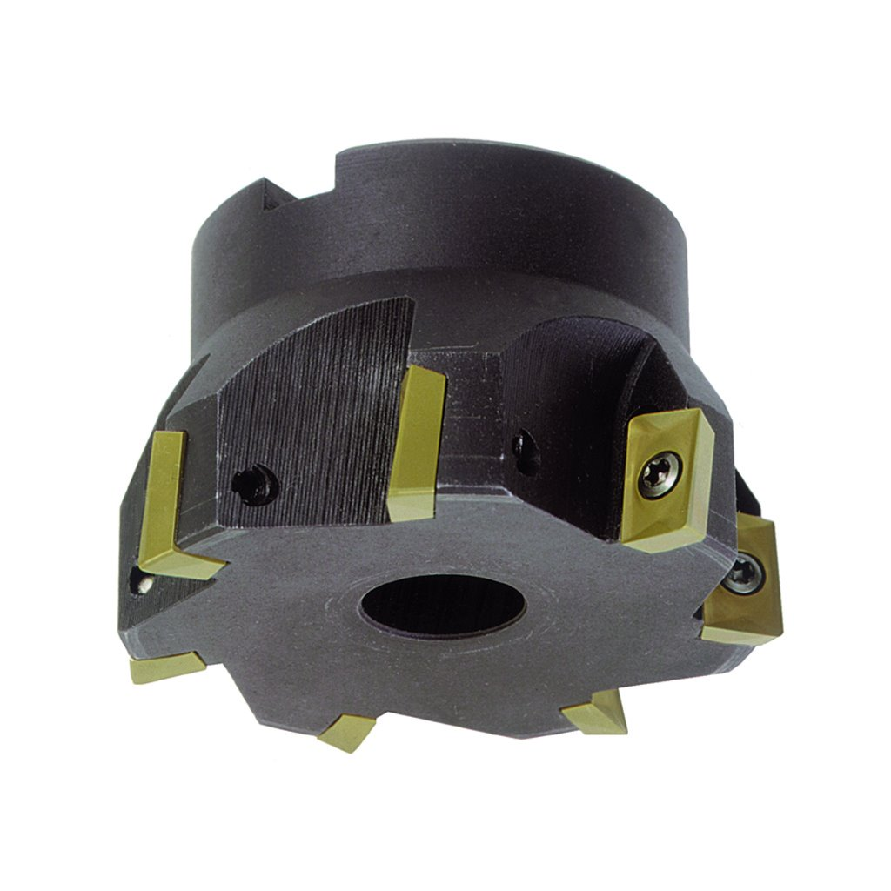
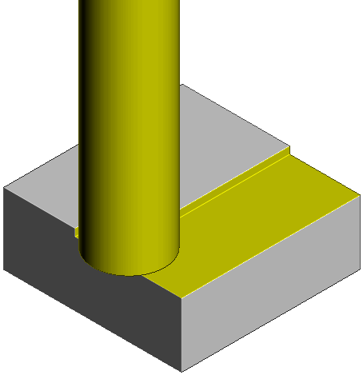
Material: Carbide, Cobalt, and Diamond for high-speed applications. HSS for general metal machining.
Finished surface
Insert
Fig. 6: Face milling cutter [7]
Fig. 7: Finished product [8]

Slide 8
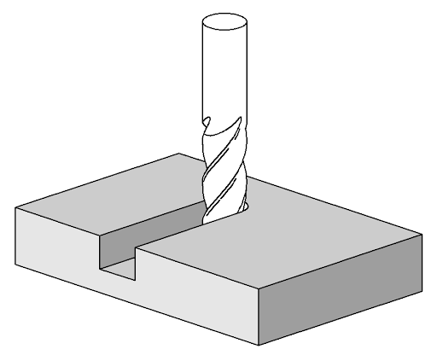
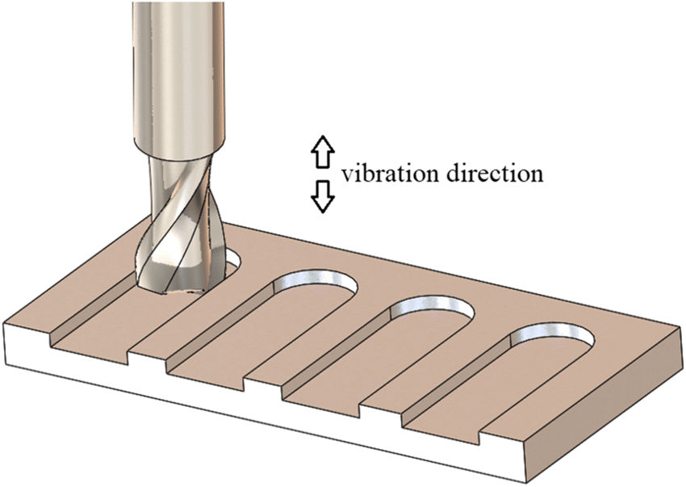
Slot Milling (Saw Milling)
Width of cutter less than the width of workpiece.
d= depth of cut
d
Fig. 8: Schematic of saw milling [9]
Fig. 9: Finished product [10]

Slide 9
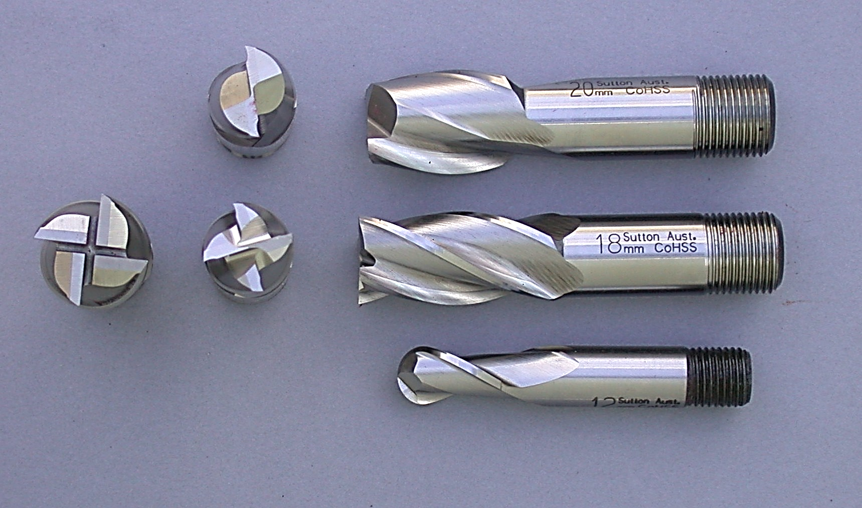
Cutters: End mill cutters used having cutting teeth at one end, as well as on the periphery.
Material: HSS
Cross-section
Fig. 10: End milling cutter - HSS [11]

Slide 10
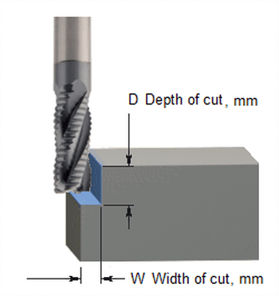
Material removal rate (MRR)
MRR = D × W × F
1000
D: Depth of cut, mm.
W: Width of cut, mm.
F: Feed rate, mm/min.
MRR, cc/min.
[12]

Slide 11
References
https://www.custompartnet.com/wu/milling
https://engineering.myindialist.com/2009/principle-and-working-of-milling-machine/#.YQvNoogzY2w
https://www.sandvik.coromant.com/en-us/knowledge/milling/pages/up-milling-vs-down-milling.aspx
https://fractory.com/horizontal-vs-vertical-milling/
https://www.mechanicalbooster.com/2016/12/what-is-milling-machine-operation-parts-types.html
https://www.manufacturingguide.com/en/ordlista/face-milling
https://www.kbctools.com/itemdetail/6-954-060
https://knowledge.autodesk.com/support/powermill/learn-explore/caas/CloudHelp/cloudhelp/2019/ENU/PWRM-ReferenceHelp/files/GUID-47F9A737-04F5-42D4-B41D-A9AEC1B331CA-htm.html
http://toolnotes.com/home/machining/mills-101/milling-operations/
https://www.researchgate.net/figure/Schematic-of-slot-milling-process_fig2_334501874
https://en.wikipedia.org/wiki/End_mill#/media/File:MillingCutterSlotEndMillBallnose.jpg
https://cadem.com/material-removal-rate-formula/

